Slide 1
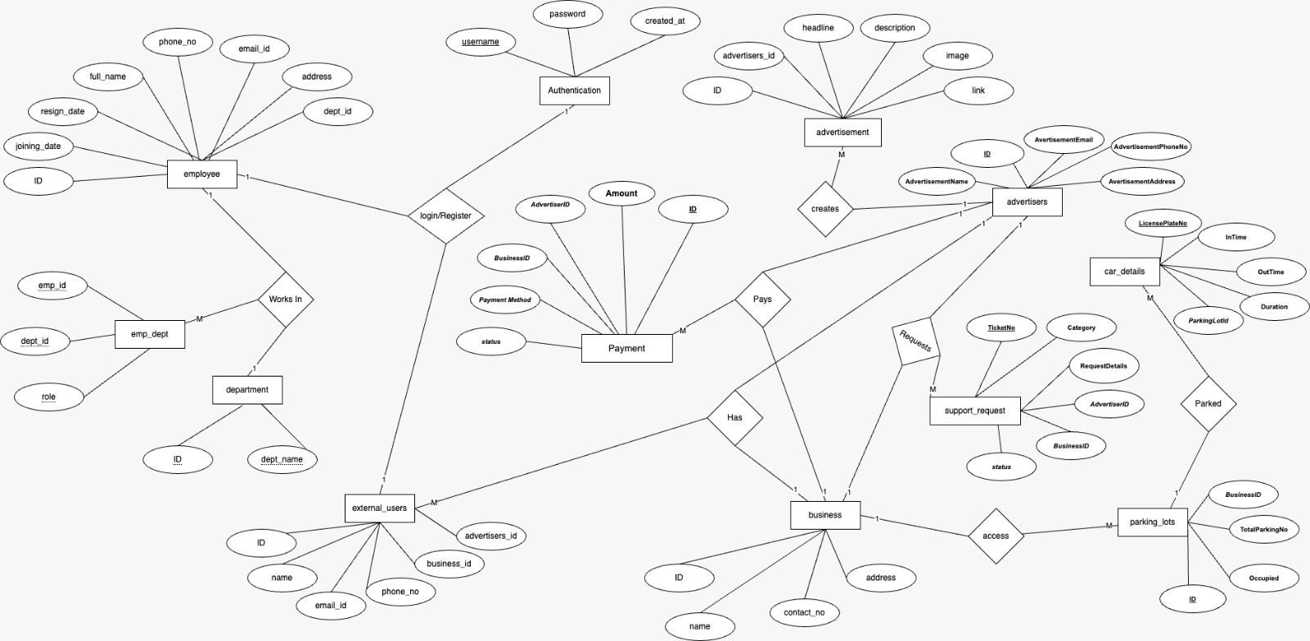
ER Diagram

Slide 2

Logical Diagram
Advertisement
Car_Details
Employee
Authentication
ID (uuid)
advertisers_id (int)
Headline (varchar)
description (boolean)
Image (boolean)
Link (boolean)
LicensePlateNo (uuid)
InTime (timestamp)
OutTime (timestamp)
Duration (double)
FK ParkingLotId (int)
1
1
Id (uuid)
joining _date (date)
Resign_date (date)
FullName (varchar)
phone_no(varchar)
Emailid (varchar)
address(varchar)
dept_id(uuid)
Username (varchar)
Password (varchar)
created_at(date)
1
M
FK
Payment
M
FK
BusinessID (uuid)
Status (enum)
ID (uuid)
Amount (double)
AdvertiserID (uuid)
PaymentMethod (varchar)
M
external_users
FK
ID (uuid)
Address (varchar)
Email (varchar)
PhoneNo (varchar)
AdvertiserID (uuid)
BusinessID (uuid)
M
Support_Request
1
Advertisers
TicketNo (uuid)
Category (varchar)
RequestDetails (varchar)
AdvertiserID (int)
BusinessID (int)
status(enum)
M
1
1
FK
FK
1
ID (uuid)
AdvertisementName (varchar)
AvertisementEmail (varchar)
AdvertisementPhoneNo (varchar)
AvertisementAddress (varchar)
M
1
FK
M
M
FK
Emp_Dept
FK
M
M
Parking_lot
Emp_id (uuid)
Dept_id (uuid)
Role (varchar)
FK
M
FK
Business
1
Department
1
1
1
FK
Id (uuid)
Name (varchar)
contact_no(varchar)
Address (varchar)
Id (uuid)
TotalParkingNo (int)
BusinessID (int)
Occupied (int)
1
M
Id (uuid)
dept_name(varchar)
1
1
M
FK

